Slide 1
Punctuation Test
Add punctuation in the correct places
How does the punctuation change the meaning of the sentence?

Slide 2

I drank two beers coffee and gin and lemonade.

Slide 3
The panda eats shoots and leaves
How do the commas change the meaning?

Slide 4
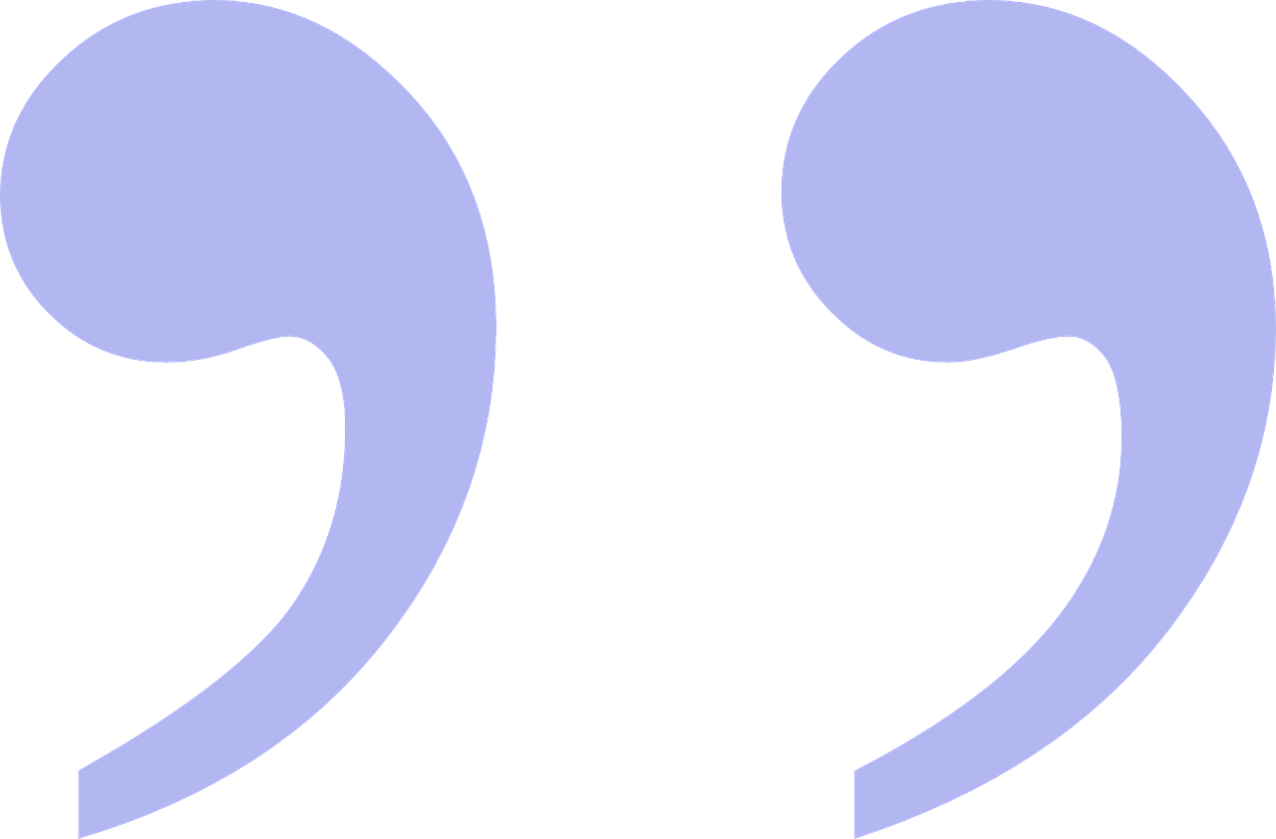
Let’s eat grandma

Slide 5

Slow children playing

Slide 6
I love my parents Princess Anne and Ed Sheeran

Slide 7

A woman without her man is nothing.

Slide 8
I went to the library fell asleep and bought some bread on my way home

Slide 9
We do not allow smoking pets or children under five

Slide 10
The wizard said pay no attention to that man behind the curtain
Where does the direct speech end?
Does ending the direct speech in a different place change the meaning?

Slide 11

The old lady collected all sorts of things silver paper hats clocks and tablecloths
-Can we change the meaning by adding more commas?

